Slide 1
Introduction to VHDL

Slide 2
Case Sensitivity
VHDL is not case sensitive. This means that the two statements shown below have the exact same meaning (don’t worry about what the statement actually means though).
Dout <= A and B;
doUt <= a AnD b;

Slide 3
White Space
VHDL is not sensitive to white space (spaces and tabs) in the source document. The two statements have the exact same meaning.
nQ <= In_a or In_b ; nQ<=in_a OR in_b;

Slide 4
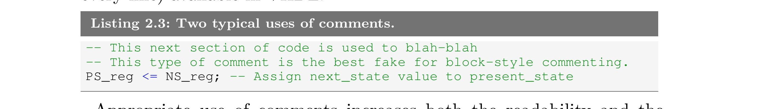
Comments
Comments in VHDL begin with the symbol “--” (two consecutive dashes). The VHDL synthesizer ignores anything after the two dashes and up to the end of the line in which the dashes appear. The below picture shows two types of commenting styles. Unfortunately, there are no block-style comments (comments that span multiple lines but do not require comment marks on every line) available in VHDL.

Slide 5
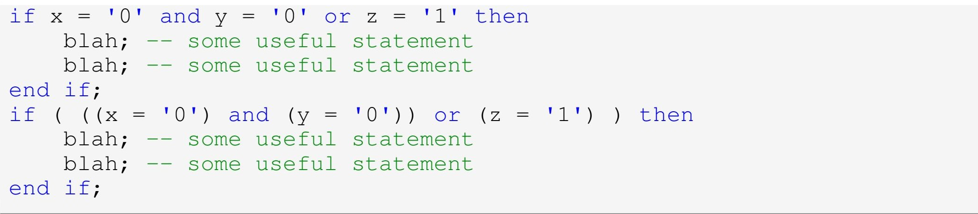
Parentheses
VHDL is relatively lax on its requirement for using parentheses. Like other computer languages, there are a few precedence rules associated with the various operators in the VHDL language. Though it is possible to learn all these rules and write clever VHDL source code that will ensure the readers of your code are left scratching their heads, a better idea is to practice liberal use of parentheses to ensure the human reader of your source code understands the purpose of the code

Slide 6
VHDL Statements
Similar to other algorithmic computer languages, every VHDL statement is terminated with a semicolon. This fact helps when attempting to remove compiling errors from your code since semicolons are often omitted during initial coding.
Identifiers
An identifier refers to the name given to various items in VHDL. Examples of identifiers in higher-level languages include variable names and function names. Examples of identifiers in VHDL include variable names, signal names and port names (all of which will be discussed soon). Listed below are the hard and soft rules (i.e. you must follow them or you should follow them), regarding VHDL identifiers.

Slide 7
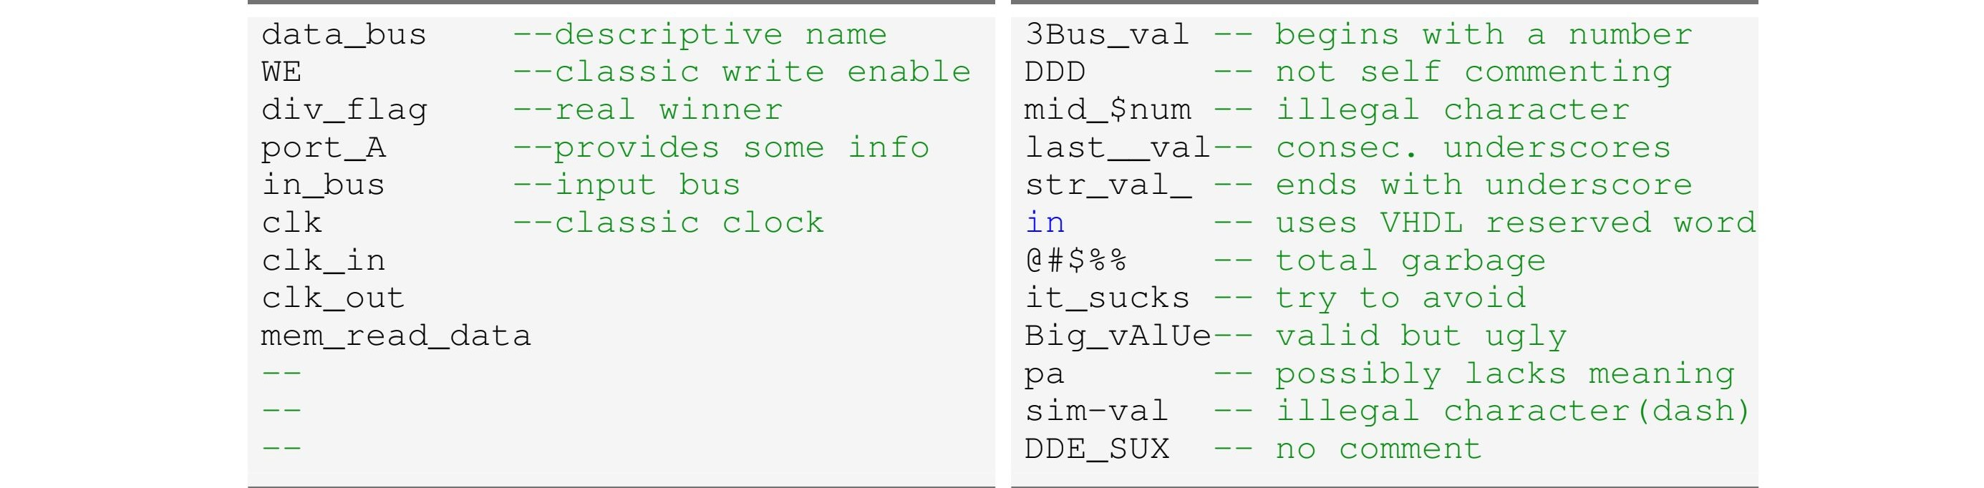
 Identifiers should be self-describing. In other words, the text you apply to identifiers should provide information as to the use and purpose of the item the identifier represents.  Identifiers can be as long as you want (contain many characters).
 Identifiers can only contain a combination of letters (A-Z and a-z), digits (0-9) and the underscore character (“ ”).
 Identifiers must start with an alphabetic character.
Identifiers must not end with an underscore and must never have two consecutive underscores.

Slide 8
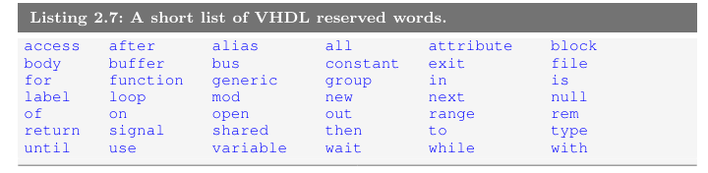
Reserved Words
There is a list of words that have been assigned special meaning by the VHDL language. These special words, usually referred to as reserved words, cannot be used as identifiers when writing VHDL code. A partial list of reserved words that you may be inclined to use appears below.

Slide 9
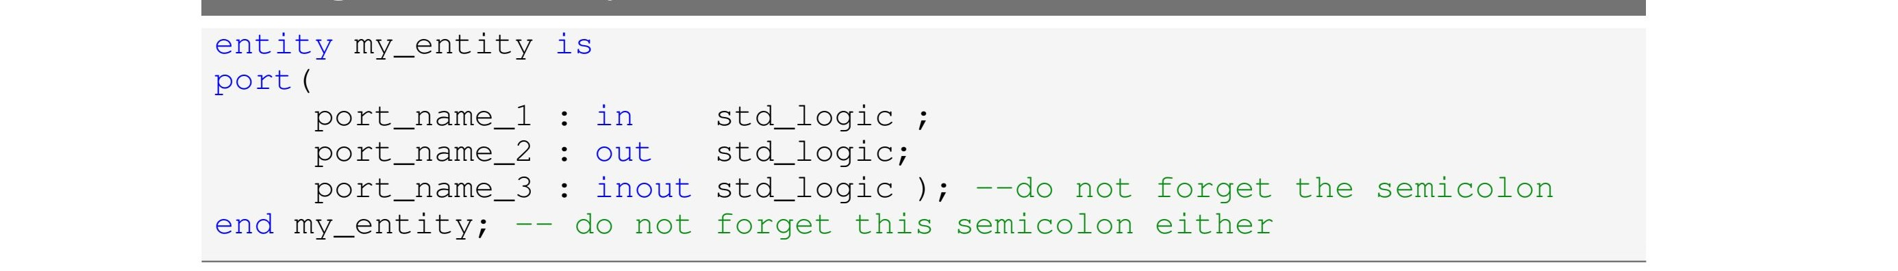
Entity
The VHDL entity construct provides a method to abstract the functionality of a circuit description to a higher level. It provides a simple wrapper for the lower-level circuitry. This wrapper effectively describes how the black box interfaces with the outside world. Since VHDL describes digital circuits, the entity simply lists the various inputs and outputs of the underlying circuitry. In VHDL terms, the black box is described by an entity declaration. The syntax of the entity declaration is shown below.

Slide 10
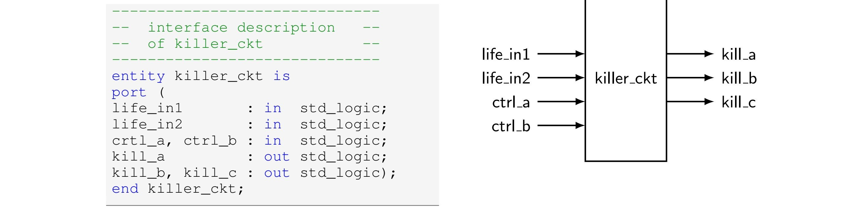
The above picture shows an example of a black box and the VHDL code used to describe it. Listed below are a few points to note about the code.
Most of the points deal with the readability and understandability of the VHDL code.  Each port name is unique and has an associated mode and data type. This is a requirement.  The VHDL compiler allows several port names to be included on a single line. Port names are separated by commas. Always strive for readability.

Slide 11
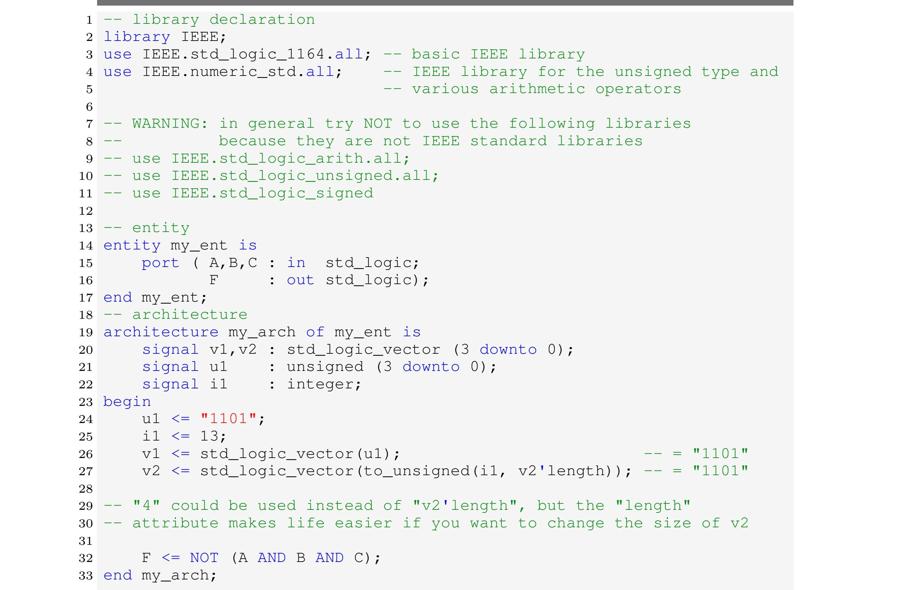
VHDL Standard Libraries
The VHDL language as many other computer languages, has gone through a long and intense evolution. Among the most important standardization steps we can mention are the release of the IEEE Standard 1164 package as well as some child standards that further extended the functionality of the language.

Slide 12
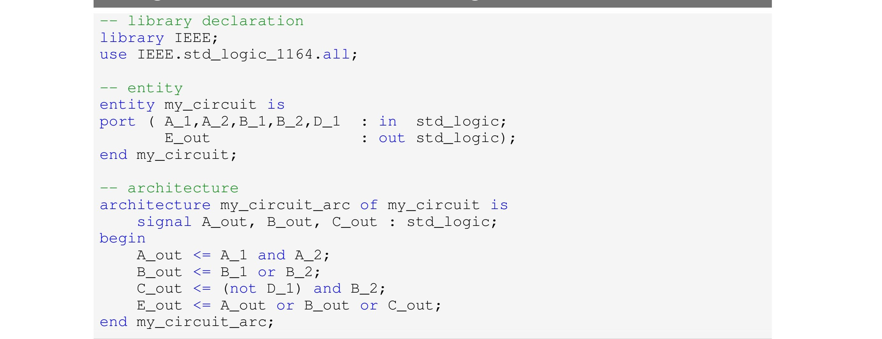
Architecture
The VHDL entity declaration, introduced before, describes the interface or the external representation of the circuit. The architecture describes what the circuit actually does. In other words, the VHDL architecture describes the internal implementation of the associated entity. As you can probably imagine, describing the external interface to a circuit is generally much easier than describing how the circuit is intended to operate. This statement becomes even more important as the circuits you are describing become more complex.

Slide 13
Concurrent Statements
At the heart of most programming languages are the statements that form a majority of the associated source code. These statements represent finite quantities of actions to be taken. A statement in an algorithmic programming language such as C or Java represents an action to be taken by the processor. Once the processor finishes one action, it moves onto the next action specified somewhere in the associated source code.
VHDL programming is significantly different. Whereas a processor steps one by one through a set of statements, VHDL has the ability to execute a virtually unlimited number of statements at the same time and in a concurrent manner (in other words, in parallel). Once again, the key thing to remember here is that we are designing hardware. Parallelism, or things happening concurrently, in the context of hardware is a much more straightforward concept than it is in the world of software.

Slide 14
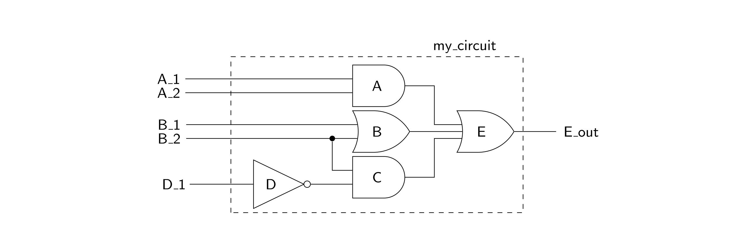

Slide 15
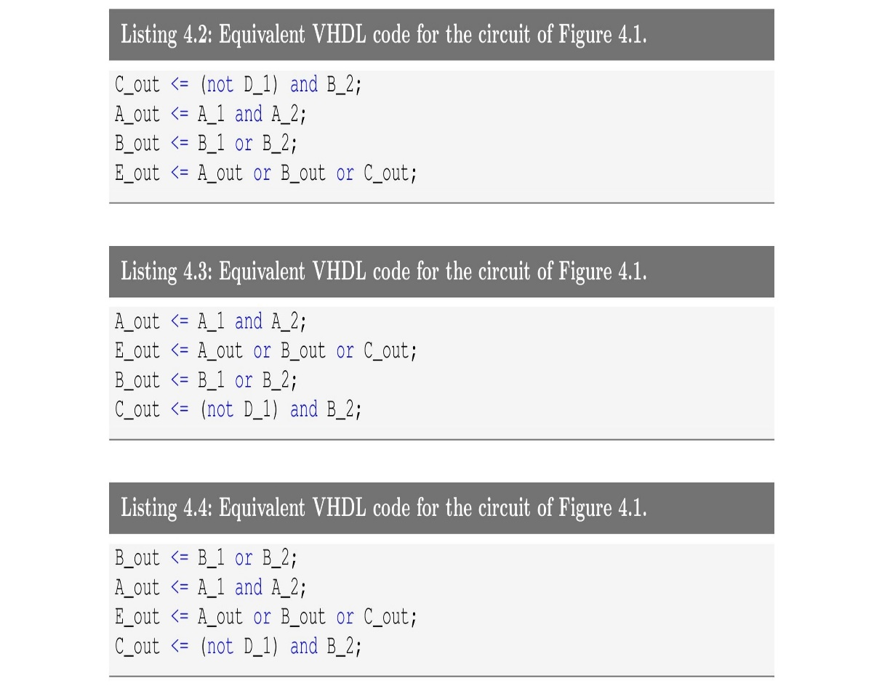
As a consequence of the concurrent nature of VHDL statements, the three chunks of code appearing below are 100% equivalent to the code shown

Slide 16
Signal Assignment Operator “<=”
Algorithmic programming languages always have some type of assignment operator. In C or Java, this is the well-known “=” sign. In these languages, the assignment operator signifies a transfer of data from the right-hand side of the operator to the left-hand side. VHDL uses two consecutive characters to represent the assignment operator: “<=”. This combination was chosen because it is different from the assignment operators in most other common algorithmic programming languages. The operator is officially known as a signal assignment operator to highlight its true purpose. The signal assignment operator specifies a relationship between signals. In other words, the signal on the left-hand side of the signal assignment operator is dependent upon the signals on the right-hand side of the operator.
Syntax:
<target> <= <expression> ;

Slide 17
Problem:
Write the VHDL code to implement the function expressed by the following logic equation:
F3 = L’ · M’ · N + L · M

Slide 18
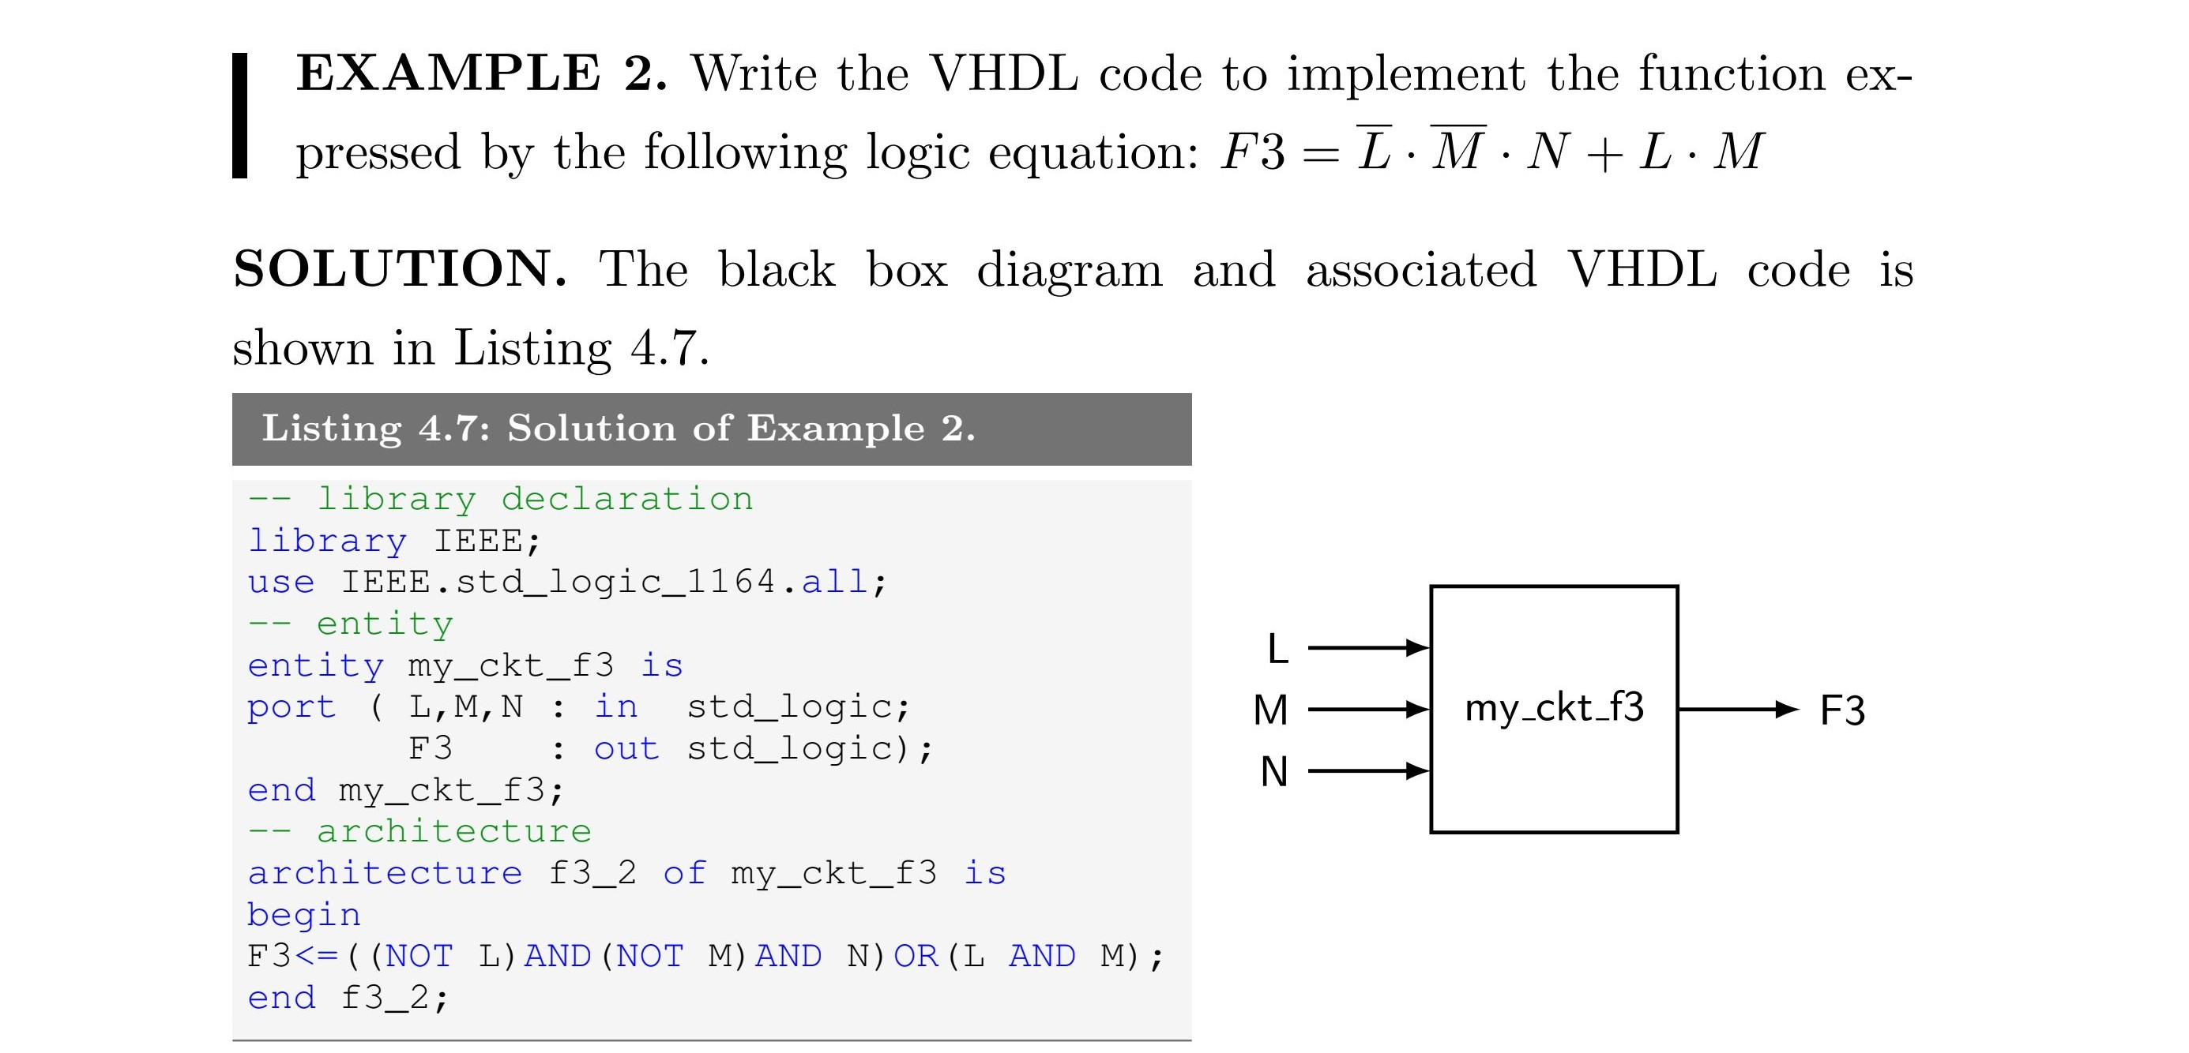
Solution:

Slide 19
Thank You!
Have a nice day ☺

